Slide 1
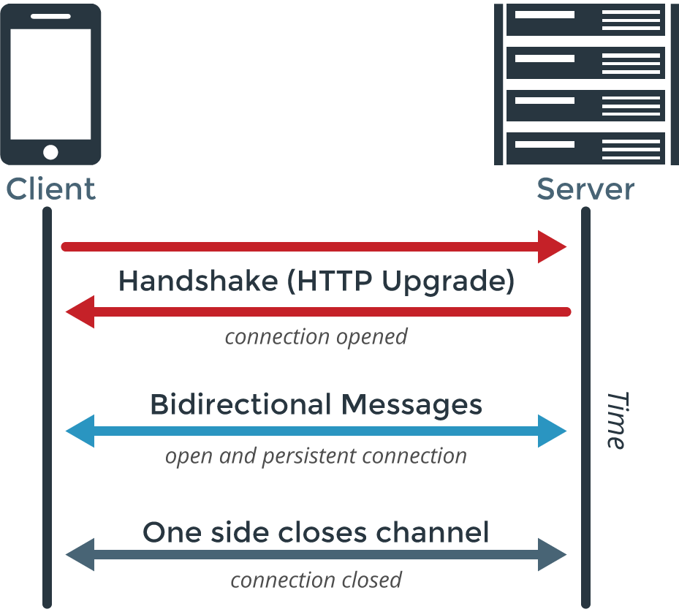
WEBSOCKET CHAT
Websockets let the server and client communicate whenever they have data to send, without the client making http requests.
It can be a lot faster…
no HTTP request/response (after initial handshake)
full-duplex -meaning: client or host can send data at any time, in both directions

Slide 2
Technology Stack:
asynchronous Node.js (the server-side code)
  Heroku
  websocket
  es6 babel
React.js (the front-end code)
  React components form a page which updates CHANGES, rather than the entire DOM
Testing
  Chai
  Jasmine
  nyc/Istanbul (provides test coverage information)
  sdf

Slide 3
team:
Irbe, Jordan, Mathew, north
4 makers just making some shit.
that’s how it is.

Slide 4
goals:
learn cutting-edge web technologies
learn to use a websocket to transfer data client-to-host and host-to-client
learn cutting-edge web technologies
learn cutting-edge web technologies
Process:
research first
test driven
continuous integration
much agile
documentate

Slide 5
successes and challenges :
learn cutting-edge web technologies –Yes, we did
Continuous deployment –TravisCI helps ensure deployed version always works
Good teamwork
4 makers just making some shit.

